Slide 1
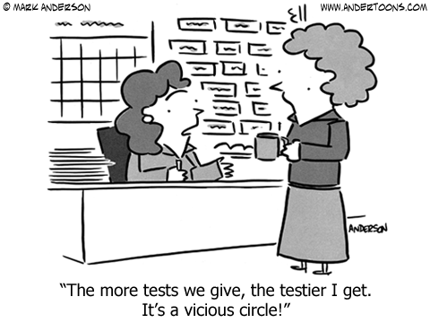

Slide 2
WHY ARE WE TAKING SO MANY TESTS?
Education Reform and the Modern Accountability Movement
Wayne Zhang

Slide 4
Do you like tests?
What does a test measure? (Why do we take them at all?)
What is the achievement gap?

Slide 5
4) Why are we taking so many tests?
(What is the accountability movement?)
5) Are tests good at measuring what they’re supposed to measure?
(Is the accountability movement working?)

Slide 6
1) Do you like tests?

Slide 7
NO, THEY SUCK

Slide 8
Different types of Tests
Formative
Measures where you are
Examples: daily quizzes
Summative
Counts for something
“Standardized Tests”
SAT, ACT, State sponsored exams (ISTEP)

Slide 9
2) What do tests measure?
(Why do we take tests at all?)

Slide 10
Intelligence
Memorization
How hard someone studies

Slide 11
How well is the teacher teaching?
How well is the school providing for its students?

Slide 12
3) What is the achievement gap?

Slide 13
Achievement gap
Lower income
Minority Students
Arises from differences in school resources, access to health care, access to childcare.

Slide 14
What does accountability mean?

Slide 15
What does accountability in education mean?

Slide 16
What is the education accountability movement?
An effort to close the achievement gap, by tracking achievement for different subsets of students
Like a doctor diagnosing a patient, and then giving them a prescription
Data is collected through standardized tests

Slide 17
4) Why are we taking so many tests?

Slide 18
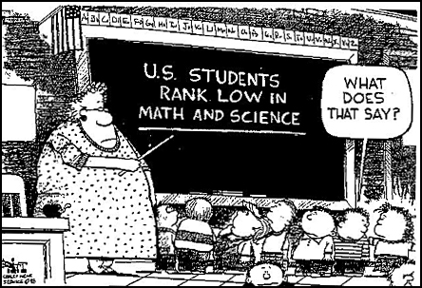

Slide 19
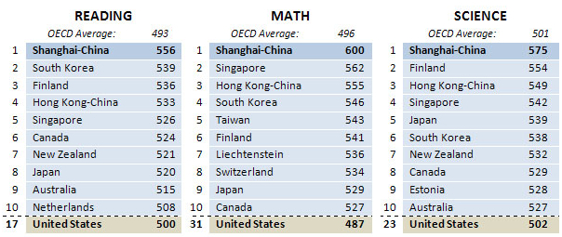
PISA 2012 Results

Slide 21
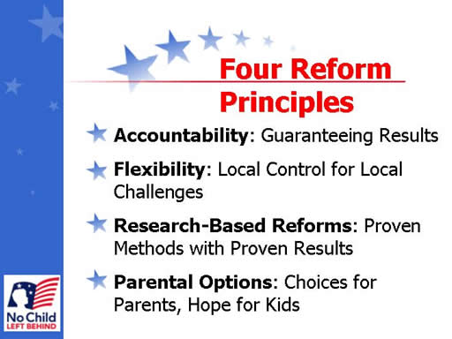
No Child Left Behind - 2001
Mandates that states have to track student progress
Minorities
Socioeconomic status
Schools that repeatedly failed to show progress were closed

Slide 22
SEC. 1001. STATEMENT OF PURPOSE
The purpose of this title is to ensure that all children have a fair, equal, and significant opportunity to obtain a high-quality education and reach, at a minimum, proficiency on challenging state academic achievement standards and state academic assessments.

Slide 23
NCLB - 2001
All states are required to create their own exams to track progress
Problem #1: different states are have different standards
It is possible to proficient in one state, but below basic in another state (Mississippi & Illinois)
Problem #2: schools are closing before they have the chance to improve
“HIGH STAKES TESTING”

Slide 24
Race to the Top - 2009
States compete for 4.35 billion dollars of funding
In exchange, agree to
Teacher evaluations based on test scores
Implementation of Common Core
Remove of cap for charter schools
18 states & District of Columbia get funding
Over 45 states change laws

Slide 25
Common Core - 2010
Universal standards for what students should from K-12 at the end of each grade in Math and English
Tests based upon universal standards

Slide 26
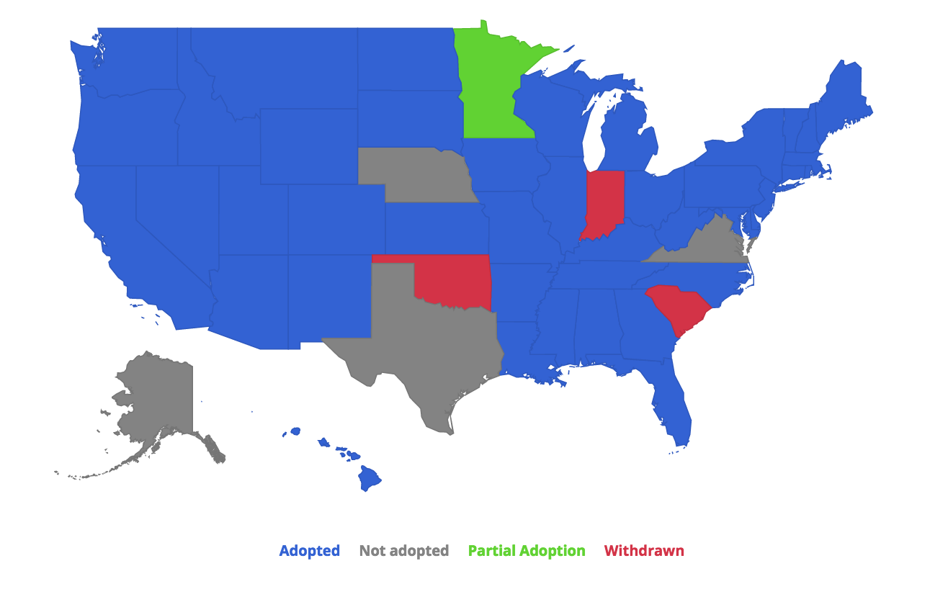
http://academicbenchmarks.com/common-core-state-adoption-map/

Slide 27
WHY SO MANY TESTS?
Tests from NCLB
------ Tests from Common Core
The higher the stakes associated with the standardized tests, the more likely teachers are to give formative assessments

Slide 28
5) Are tests good at measuring what they’re supposed to measure? (i.e. Is the accountability movement working?)

Slide 29
Should we have tests at all?

Slide 30
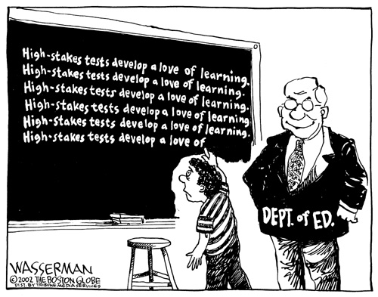
Started off as a means to an end, the became an end?

Slide 32
Should we have the tests we have now?

Slide 33
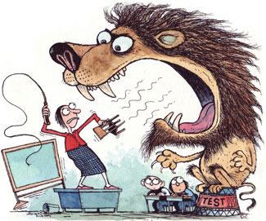
Too much time testing, not enough time teaching?

Slide 34
http://www.washingtonpost.com/blogs/answer-sheet/wp/2012/11/11/time-on-testing-738-minutes-in-3-weeks/
One Chicago high school: 3 weeks = 738 minutes (12 hours and 18 minutes) prepping for and administering standardized tests
Many elementary school classrooms use up to four different tests two or three times a year (combo of diagnostic/formative and achievement/summative): up to ~10 weeks of testing

Slide 35
Should we have the stakes that we have attached to tests that we do now?

Slide 36
Issues With Using Standardized Assessments of Student Performance for Accountability
WHAT the tests measure
“Good” test vs. “bad” test
Can a standardized test be “good”?
HOW the tests measure
Status/cohort models versus growth/value added models
Subgroup definitions
Standard margin of error and bias
Missing data
Interference
CONSEQUENCES
School context

Slide 37
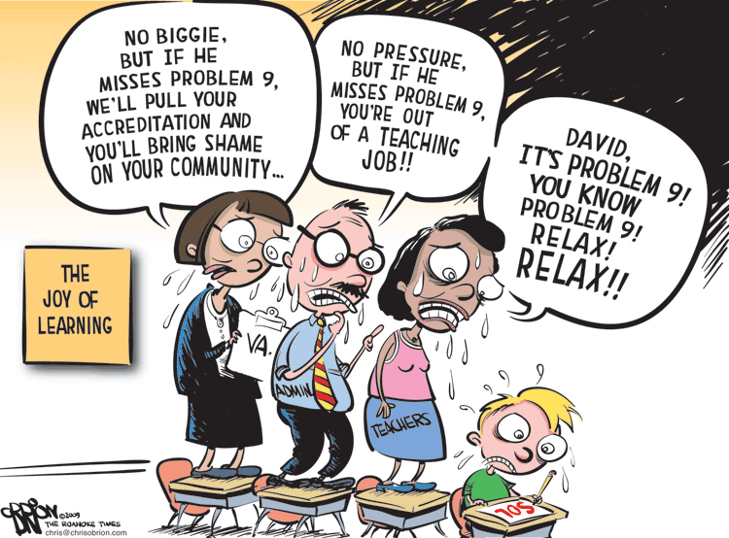

Slide 38
Are teachers being unfairly fired?
How can education get better if a school is closed?
Is the Common Core opt out movement good? Throw the baby out with the bathwater
Are they undermining the overall idea that they might agree with?

